Slide 1
COR™ Associate Auditor Program
CSSE Toronto Chapter
November 8, 2016

Slide 2
Agenda
COR™ in Ontario
Certification Benefits
Current IHSA Status
Associate Auditor Program - PILOT

Slide 4
Certificate of Recognition (COR™)
COR™ is a health and safety certification program
National standard supported by the Canadian Federation of Construction Safety Association (CFCSA)
Aimed at driving positive workplace behaviours and consistent practices which lead to improved performance

Slide 5
COR™ Audit Elements Common to all Jurisdictions
Policy Statement
Hazard Analysis
Safe Work Practices
Safe Job Procedures
Company Rules
Personal Protective Equipment
Preventive Maintenance
Training & Communication
Workplace Inspections
Investigations & Reporting
Emergency Preparedness
Statistics & Records
Legislation

Slide 6
COR™ Audit Elements Specific to Ontario
Occupational Health
First Aid
Health & Safety Rep/Committee
Workplace Violence & Harassment
Return to Work
Management Review

Slide 7
IHSA’s Role
IHSA is the only approved provider (registrar) of COR™ in Ontario
IHSA administers the COR™ cycle, publishes participant progress, updates www.ihsa.ca
Set ISO 19011 as the standard for Lead Auditor training (40 hours)
Competent IHSA Auditors conduct workplace audits
COR™ Participant Guidelines

Slide 8
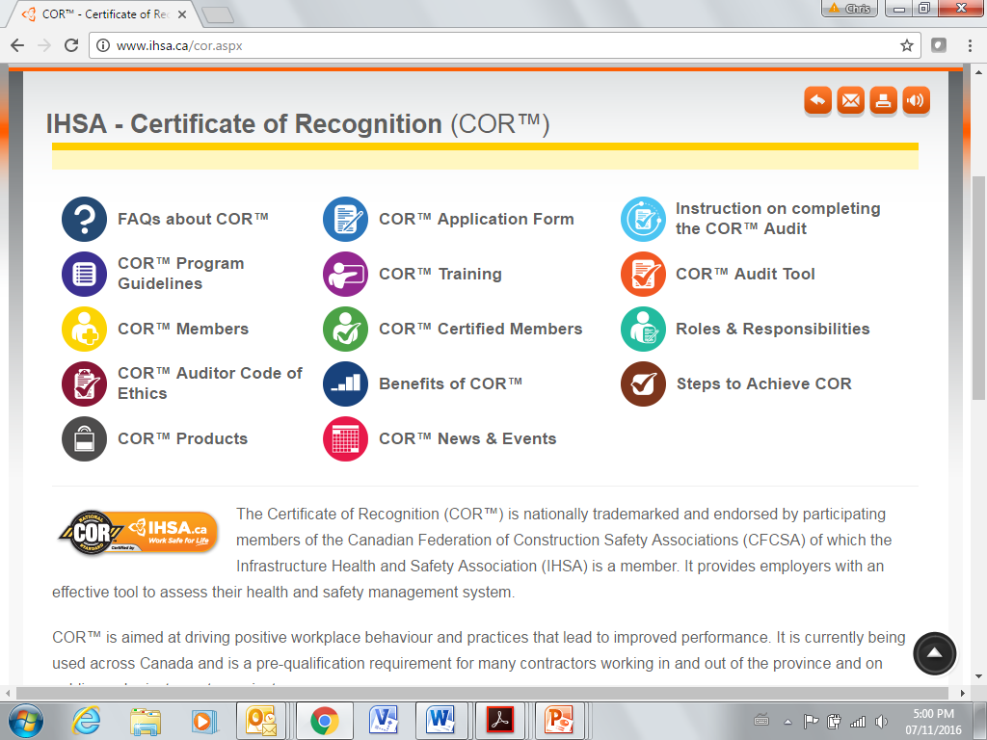

Slide 9
COR™ Cycle

Slide 10
COR™ & Your Company’s OH&S Program
COR™ certified companies are able to align their current OH&S program to the audit requirements: identify where each element exists
Successful workplaces identify program gaps, during their self audit, and make improvements
COR™ firms are able to demonstrate consistent application of their OH&S program throughout their workplace(s)

Slide 11
Benefits to the Workplace
Road map to developing a recognized health and safety management system (Safety Plan)
Levels the playing field for contractors who invest in their health and safety program
Proven process to maintain performance and achieve ongoing regulatory compliance
Elimination of hurdles to pre-qualify on projects in other Canadian jurisdictions
COR™ workplaces must provide OH&S training and communication to all employees to demonstrate that a system exists

Slide 12
Benefits to the Buyers/Users
Confidence that a COR™ certified firm has demonstrated that they meet or exceed a recognized national standard (confirmation of legal compliance and OH&S management system)
Opportunity to reduce bidding and tendering complexities aimed at validating health & safety programs
Ability to raise the bar and improve the likelihood of meeting project timelines

Slide 13
Benefits to Workers
Partnership for Health & Safety, University of BC.
10 year study from 2002 – 2012.
Question: Is certification associated with lower work-injury rates?
Findings: 12% lower STD, LTD & Fatalities
17% lower serious injury rate
COR™ program participation is associated with lower injury rates.

Slide 14
Benefits to Workers
Alberta Human Services (equivalent to MOL) reported in 2012 that COR™ firm participation compared to non-COR™ firms;
COR™ firms have fewer work stoppages by 31.6%
COR™ firms have 32% lower fatality rate
COR™ firms have 10% lower lost time rate
COR™ firms make up 50% of Alberta payroll

Slide 15
Additional Benefits – Survey (conducted by IHSA of workplaces participating in COR™ )
88% expect an increased ability to bid on jobs
56% expect a reduction in incidents
56% expect increased corporate image
50% expect increased customer satisfaction
50% expect increased incident reporting
38% expect increased morale

Slide 16
Benefits to Small Business/Contractors
COR™ in Ontario has the same requirements for every participant regardless of size
Small contractors are required to manage their health and safety programs relative to their size
IHSA has created an affordable e-learning program which assists small contractors to develop and manage the 19 elements of COR™

Slide 17
The Competitive Edge
Contractor
Greater Toronto Airport Authority
Brampton Hydro
City of Toronto
Metrolinx
York Region
Infrastructure Ontario
TTC

Slide 18
Growing Participation (n = 157)

Slide 19
COR™ Associate Auditor Program
Improve our membership’s access to COR™ by extending it’s capacity through the development of an Associate Auditor network. This network will allow IHSA to focus more on the oversight of auditors, and through quality assurance, ensure that our membership receive consistent and reliable auditing services for the COR™ program.

Slide 20
COR™ Associate Auditor Pilot
Pilot duration = 12 months
COR™ Associate Auditor
Responsibilities
Application Process
IHSA
Quality Assurance

Slide 21
COR™ Associate Auditor - Responsibilities
*
*
* COR™ Associate Auditor

Slide 22
IHSA Quality Assurance
Oversight to ensure consistency and reliability
Desktop QA – every external audit
In Field QA – once annually per auditor

Slide 23
COR™ Associate Auditor – Application Process
Contract
COR™ Associate Auditor application
COR™ Associate Auditor assignment
Required training
Sample COR™ audit

Slide 24
COR™ Associate Auditor Contact Information
Chris McKean
Cell: 647-588-2919
E: cmckean@ihsa.ca

