Slide 1
Creating a Mentally Healthy Workplace
Presented by: Addie Greco-Sanchez
President, AGS Rehab Solutions Inc
January 10, 2017
© AGS Rehab 2017

Slide 2
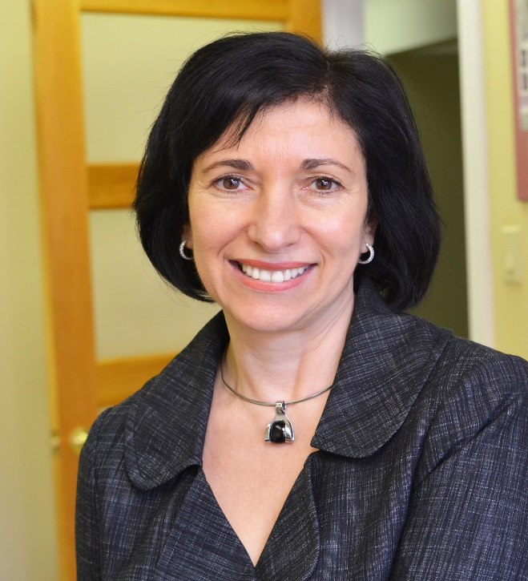
About Addie
Founder & President of AGS Rehab
Ranked on 2015 PROFIT/Chatelaine’s W100
Canada’s Top Female Entrepreneurs
Passion for industry, all things
mental health, wine and Latin music
Subject Matter Expert: Mental Health

Slide 3
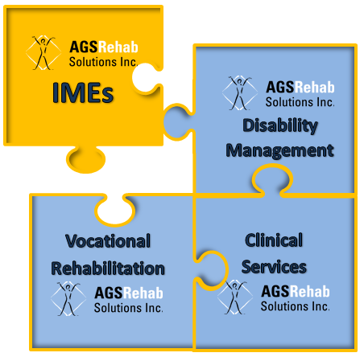
AGS Rehab Solutions Inc.
17 employees at head office and 300+ subcontractors and assessors across Canada
Provides disability management and assessment services to insurers, employers, lawyers and government agencies
Interest in all things mental health—30% of disability claims and 70% of disability costs are mental health related*
AGS, “A Great Success”
*“Face of Mental Health and Mental Illness” Public Health Agency/Health Canada

Slide 4
Small companies can do
BIG things in mental health

Slide 5
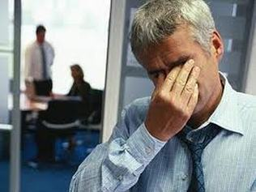
the 20th century of brawn has become the 21st century of the brain
dirty and brutish
brutishly stressful
© AGS Rehab 2017

Slide 6
National Standard of Canada for Psychological Health & Safety in the Workplace
“The Standard”:
Fosters psychological well-being and enhances organizational performance
Promotes respectful relationships between staff and customers
Supports staff experiencing psychological difficulties
Expands Occupational Health & Safety engagement systems
Have you downloaded it yet?
Source: Mental Health Commission of Canada: http://www.mentalhealthcommission.ca/English/node.5346
© AGS Rehab 2017

Slide 7
“It’s time to start thinking about mental wellbeing
in the same way as we consider physical wellbeing,
and the Standard offers the framework needed to
help make this happen in the workplace.”
~Louise Bradley, President & CEO,
Mental Health Commission of Canada
© AGS Rehab 2017

Slide 8
Manage these 13 factors to mitigate risk
© AGS Rehab 2017

Slide 9
MHCC Case Study Organizations
© AGS Rehab 2017

Slide 10
Research Objectives
Monitor implementation process and identify gaps and challenges
Determine promising practices
Inform future revisions to the Standard
Identify tools/resources to help with implementation
Create a blueprint for future organizations that wish to implement the Standard
© AGS Rehab 2017

Slide 11
Percentage of organizations endorsing this reason
Statistics provided by MHCC September 2015
© AGS Rehab 2017

Slide 12
© AGS Rehab 2017

Slide 13
AGS’s Initiatives: “The AGS Talking Cure”
Speaking out about mental health at the national and provincial levels
Talking up mental health with our customers
Walking the talk at “home”

Slide 14
What AGS Did: Walking the Talk
The AGS Vitality Series: Mindfulness to build Emotional Intelligence, Resilience and Leadership
A Lunch & Learn series of six seminars based on Google’s Search Inside Yourself
Each employee received a copy of the book, a Fitbit and the challenge to walk 10,000 steps each day.
Promoting Sleep, Step, Sweat, Reflect – the cornerstone habits for good mental health
Created a social media campaign to promote and support psychological protection
Trained managers in First Aid MH

Slide 15
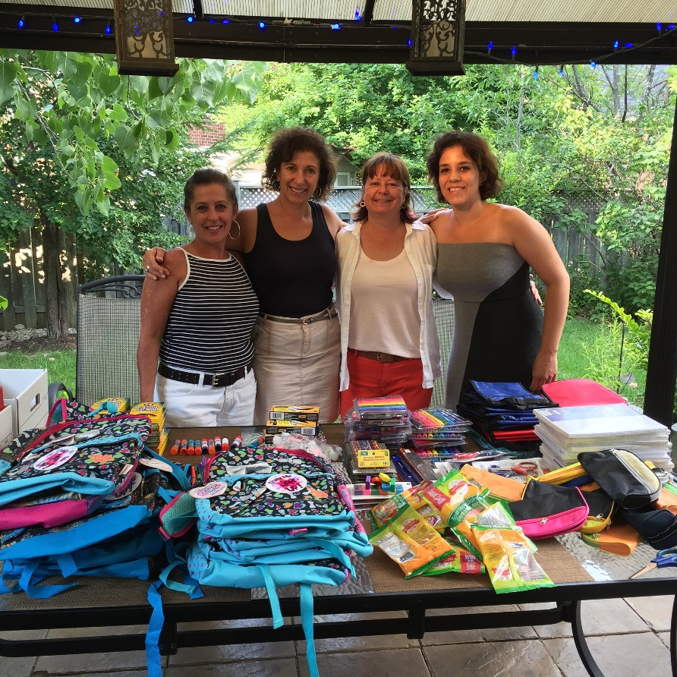
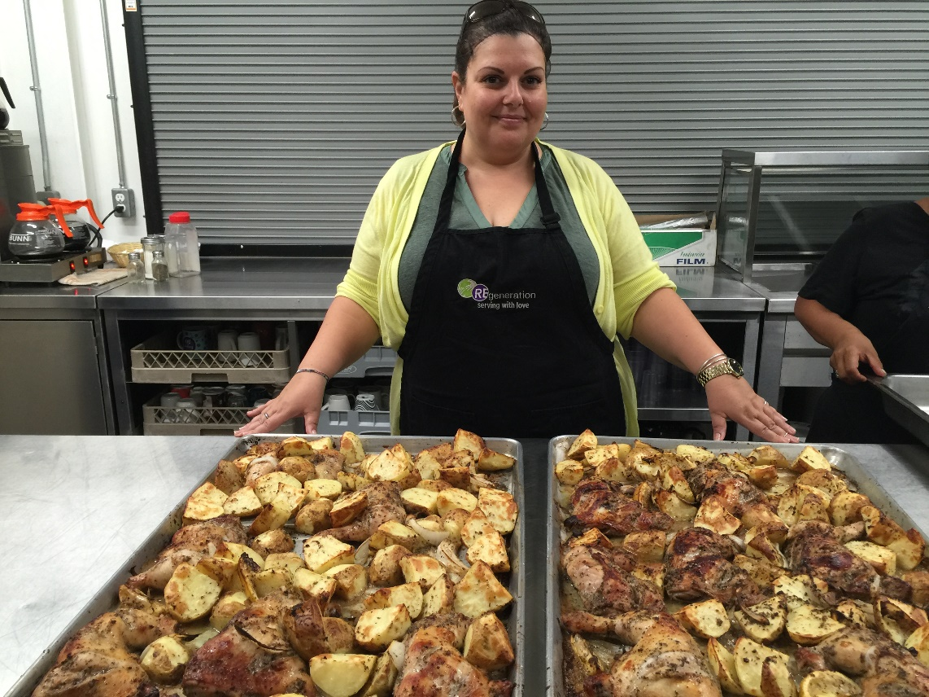
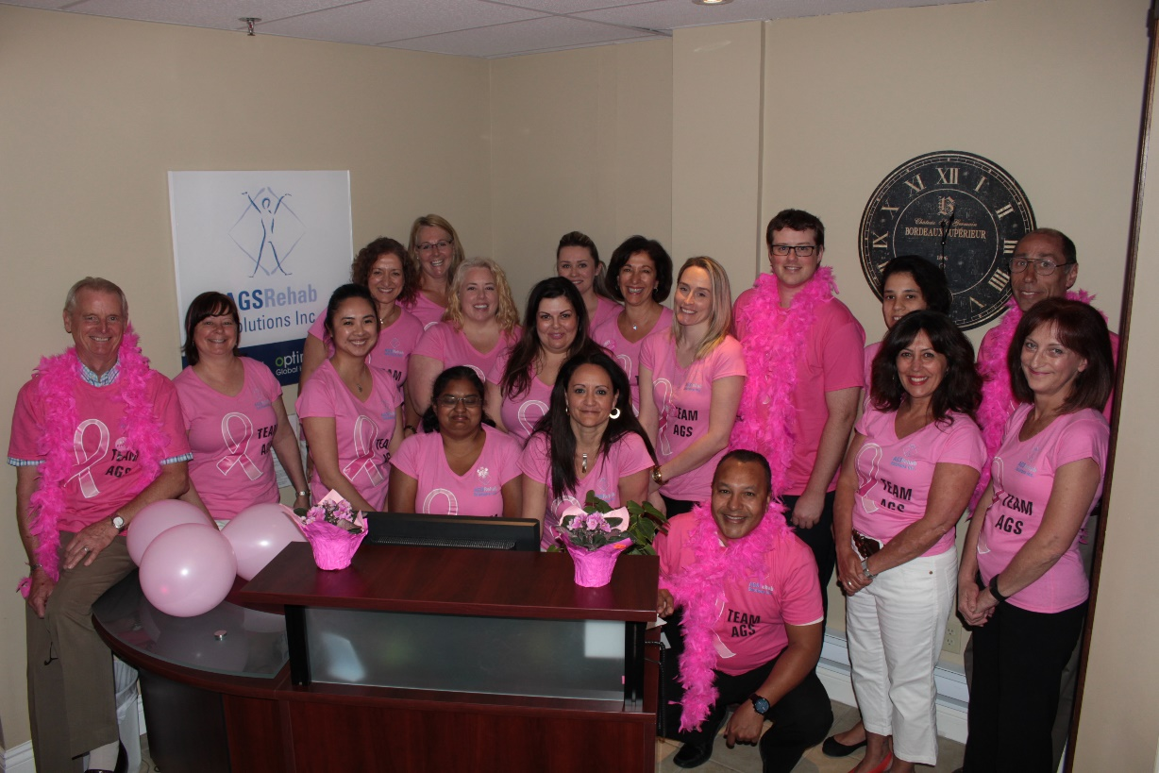
AGS’s Community Initiatives
Back To School Backpack Program

Slide 16
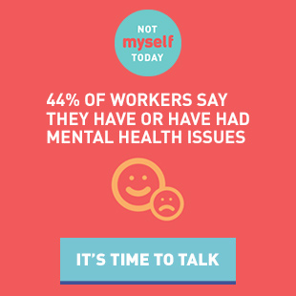
The AGS Talking Cure: Speaking out
Not Myself Today campaign sponsorship and active participation
Mental Health Commission of Canada case study advocates and active participant
Bell Let’s Talk Campaign
© AGS Rehab 2017

Slide 17
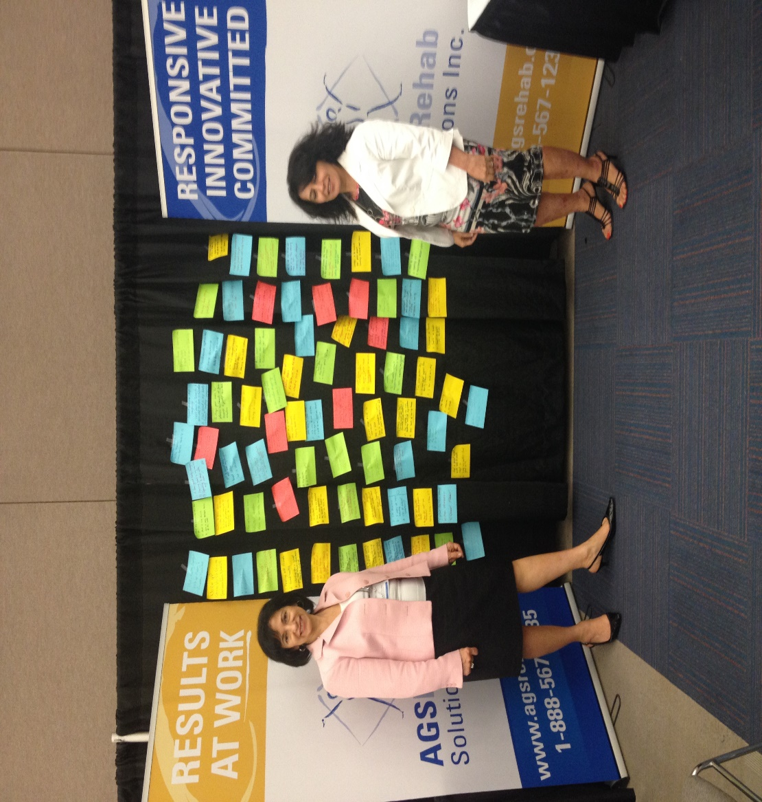
The AGS Talking Cure: “3 Good Things” Campaign
© AGS Rehab 2017

Slide 18
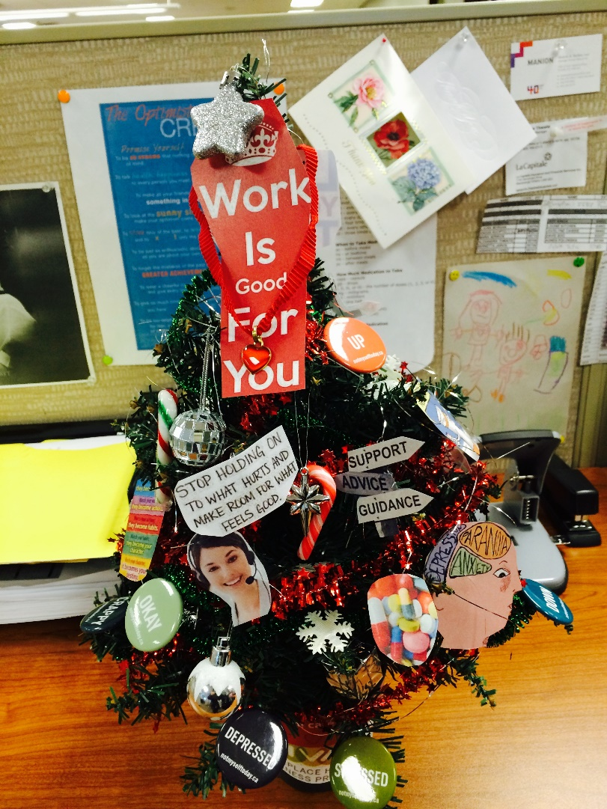
The AGS Talking Cure: Talking up Mental Health with Customers
ACE (Advanced Cognitive Expertise) product aimed specifically at measuring mental health
Getting “SOCIAL” - sharing information about mental health via LinkedIn, Facebook and Twitter
Christmas Tree Contest
© AGS Rehab 2017

Slide 19
3 Factors Driving Campaign’s Success
Corporate and social responsibility
Employee response and engagement
Recognition as an industry leader and an employer of choice
© AGS Rehab 2017

Slide 20
Challenges to Implementation
As a small corporation:
Resources
Time
Small aggregate data
Engagement
Regardless of size:
Human Capital
Financial Costs
© AGS Rehab 2017

Slide 21
Tips to Begin
Ask your employees’ opinion
Do some research
Start small with the basic steps
© AGS Rehab 2017

Slide 22
You’ll be on your way when safeguarding mental health is no longer a “nice to have” but a “that’s how we do things in this company…”
© AGS Rehab 2017

Slide 23
Questions?
© AGS Rehab 2017

Slide 24
Contact: Addie Greco-Sanchez, RRP, RVP, CVRP AGS Rehab Solutions Inc. agsanchez@agsrehab.com
Thank You!
© AGS Rehab 2017

